Slide 1
Lesson 6 – Present Simple or Present Progressive
Module 2 – Grammar Study 2

Slide 2
Present Simple
Form
Subject + V1+ ...
He is a student.
Honey is sweet.
She usually goes to bed late.

Slide 3
Use
Talk about things that are always true
Water boils at 100 degrees.
Talk about permanent situations
Sreymao lives in Kampong Cham.
Talk about habits or things that we do regularly
I drink a glass of milk every morning.
Talk about what happens in the books, plays, and films.
- At the end of the book, Daravorn gets married to Sreymao.

Slide 4
Note: Spelling of he/she/it forms
Most verbs add -s to the base form of the verb:
wants, eats, helps, drives
Add -es to verbs that end in -ss, -sh, -ch, -x, and -o:
kisses, washes, watches, fixes, goes
Verbs that end in a consonant + -y change the -y to -ies:
carries, flies, worries, tries
But verbs that end in a vowel + -y only add -s:
buys, says, plays, enjoys

Slide 5
Adverbs of frequency
An adverb of frequency describes how often an action happens.
We often use adverbs of frequency with Present Simple.

Slide 6
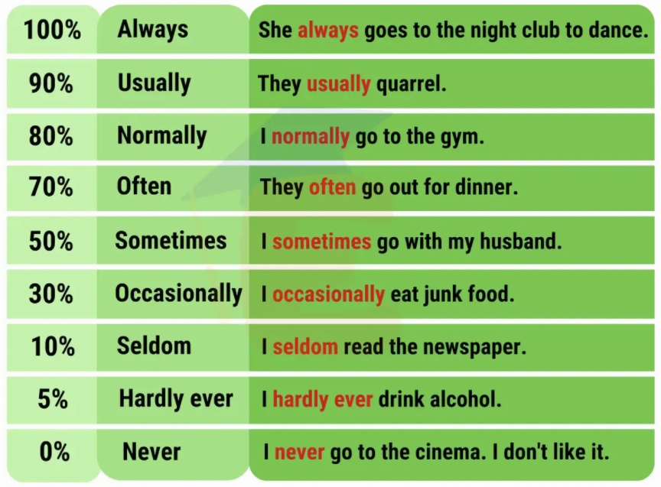
Adverb of frequency

Slide 7
We use Adverb of frequency before the main verb, but after the verb to be.
I usually have breakfast at 9:00.
They’re usually here by now.
I rarely see Peter these days.

Slide 8
Sometimes and usually can also go at the beginning or the head.
Sometimes we play cards.
Usually I go shopping with friends.
We play cards sometimes.
I go shopping with friends usually.

Slide 9
Present Progessive
Form
Subject + am/is/are + V(ing) +...
They are doing their homework now.
Sophal is watching TV in his bedroom.

Slide 10
Use
Talk about things that are happening at the moment of speaking
The water is boiling now, so you can put the tea in.
Talk about temporary situation
Sreymao is staying in Kampong Cham for a few weeks.
Talk about new actions
I’m drinking too much coffee these days because I’m busy at work.
Talk about people in the pictures or photos
In this photo, we are walking around the lake.
Talk about a planned future arrangement
I’m having lunch with my family tomorrow.

Slide 11
Note: Spelling of verb +ing
Most verbs add -ing to the base form of the verb:
going, wearing, visiting, eating
Verbs that end in one -e lose the -e:
Smoking, coming, hoping, writing *(Lie-Lying)
Verbs that end in -ee don’t drop an -e: agreeing, seeing
Verbs of one syllable, with one vowel and one consonant, double the consonant:
stopping, getting, running, planning, jogging.
IF the final consonant is -x,-y or -w, it is not doubled: boxing, playing, showing.

Slide 12





Thank you !
www.passerellesnumeriques.org

